Slide 1
Data Architecture Project Part IV
Faculty : Devin Dickens
09/12/2016
Elbio Iseas
DBM/384

Slide 2
Introduction
This part of the project addresses the exporting of the database tables to an interchange format like eXtensible Markup Language (XML ). It also updates the table through the use of XML commands, and the use of xml variables. It charges the XML file to a xml variable for its use in different parts of the project. On the following slides test scripts are used to export data from SQL Server tables to XML files.

Slide 3
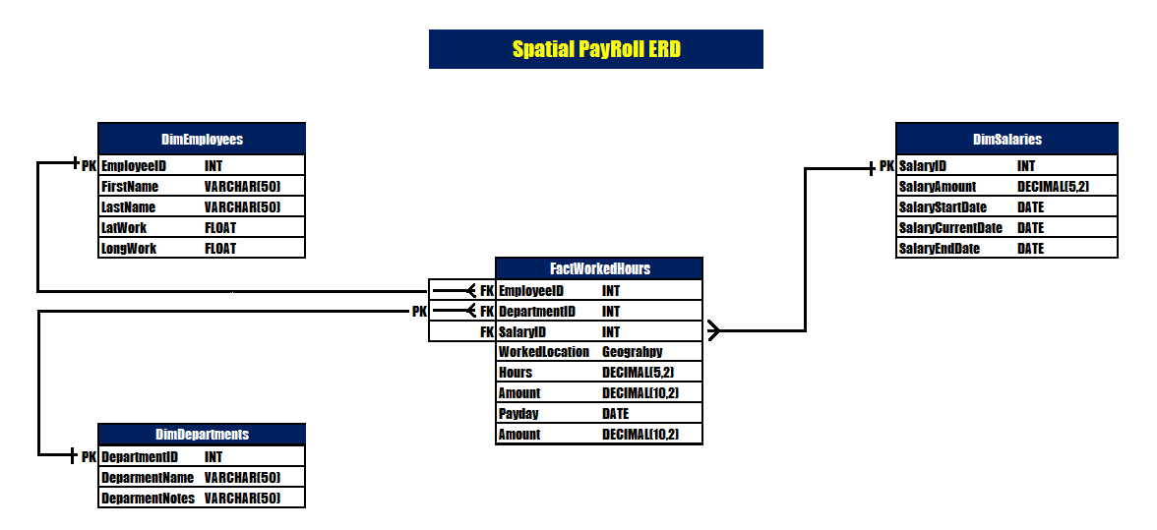
Entity Relationship Diagram
ERD of the OLTP

Slide 4
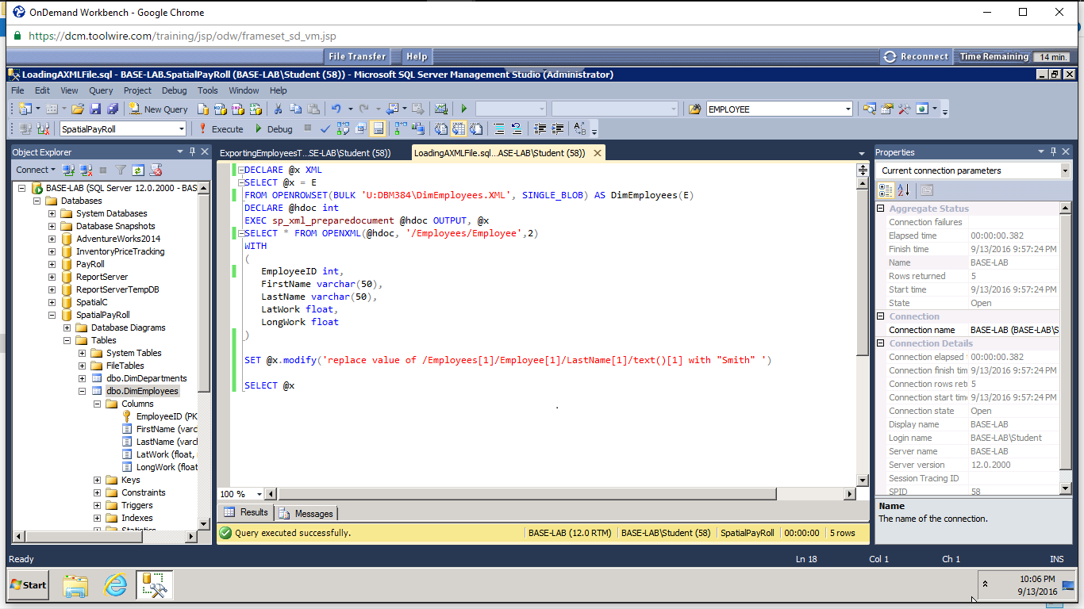
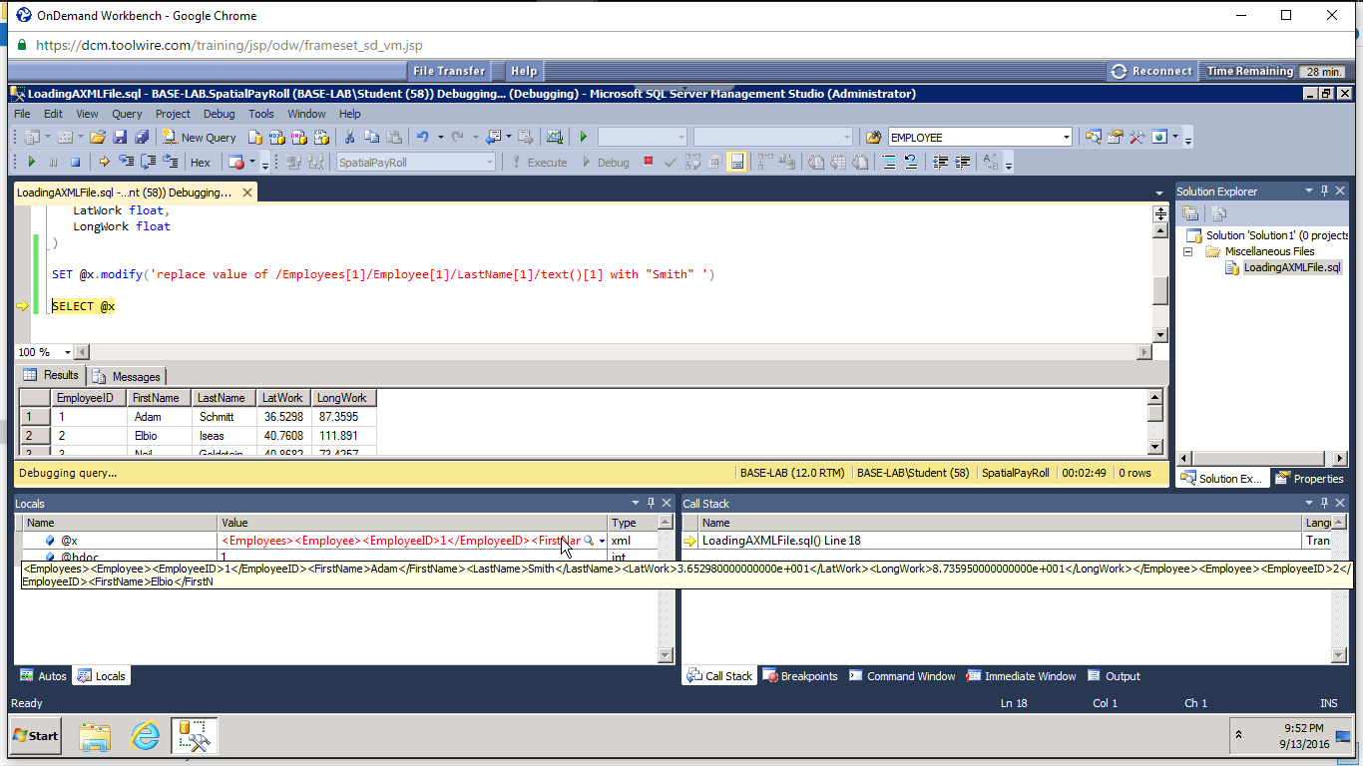
XML Script Updating Table

Slide 5
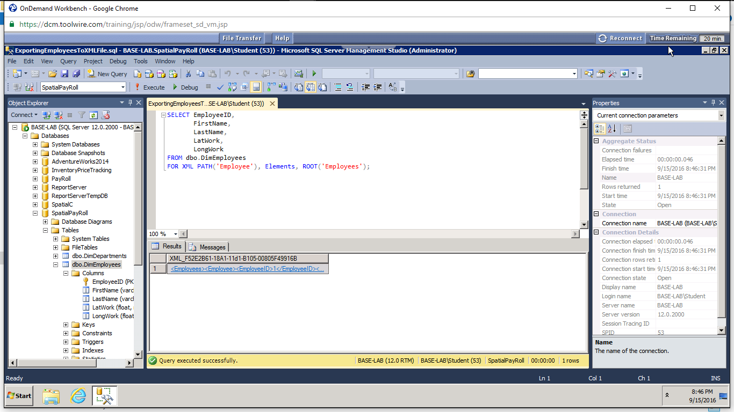
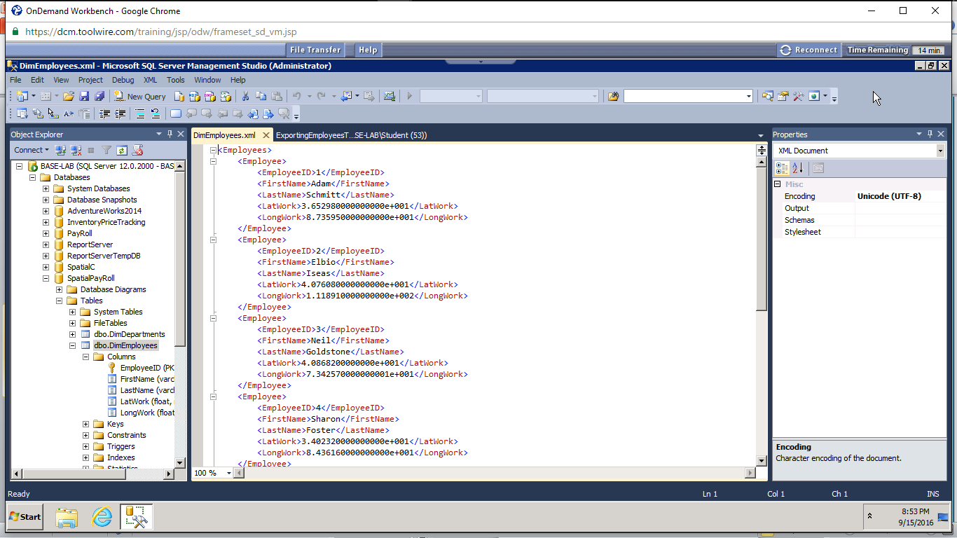
XML Script Data Feed for external dashboard

Slide 6
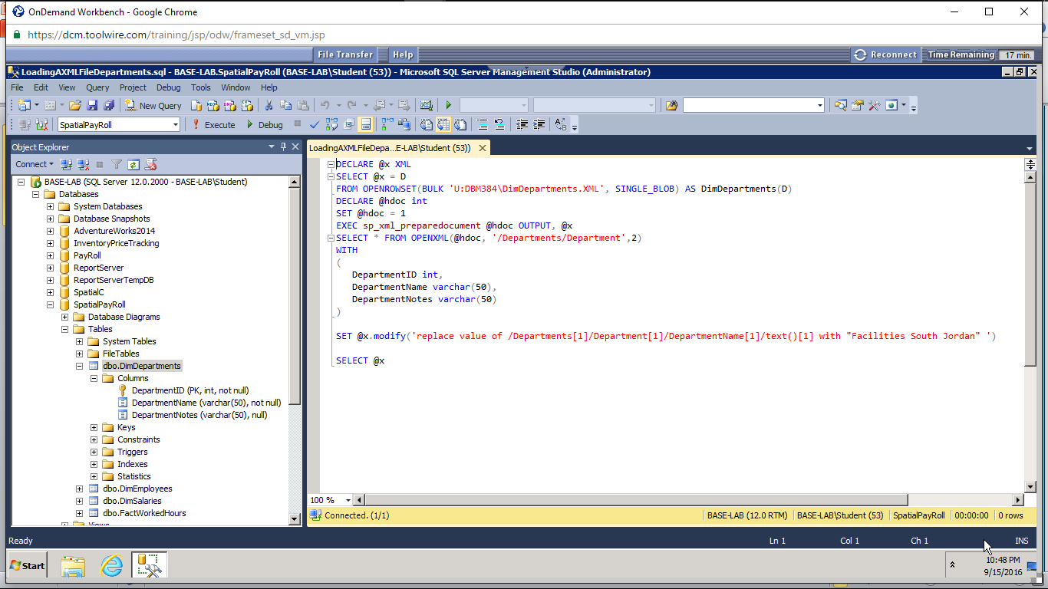
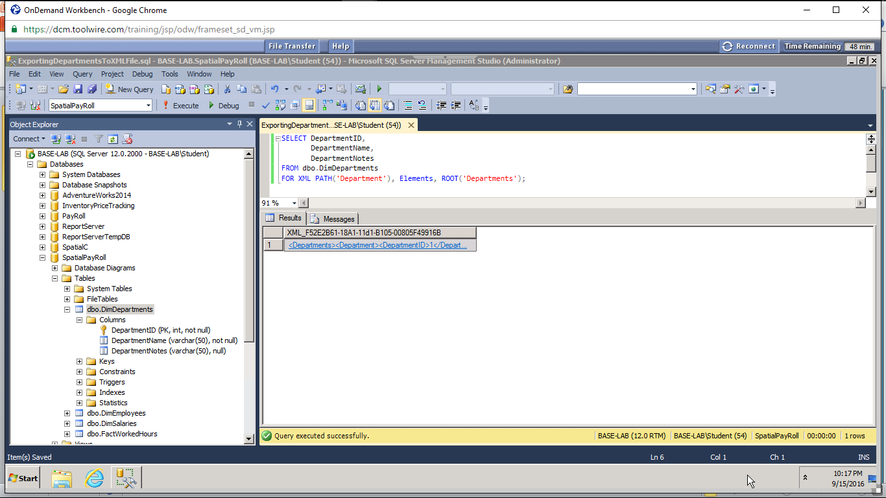
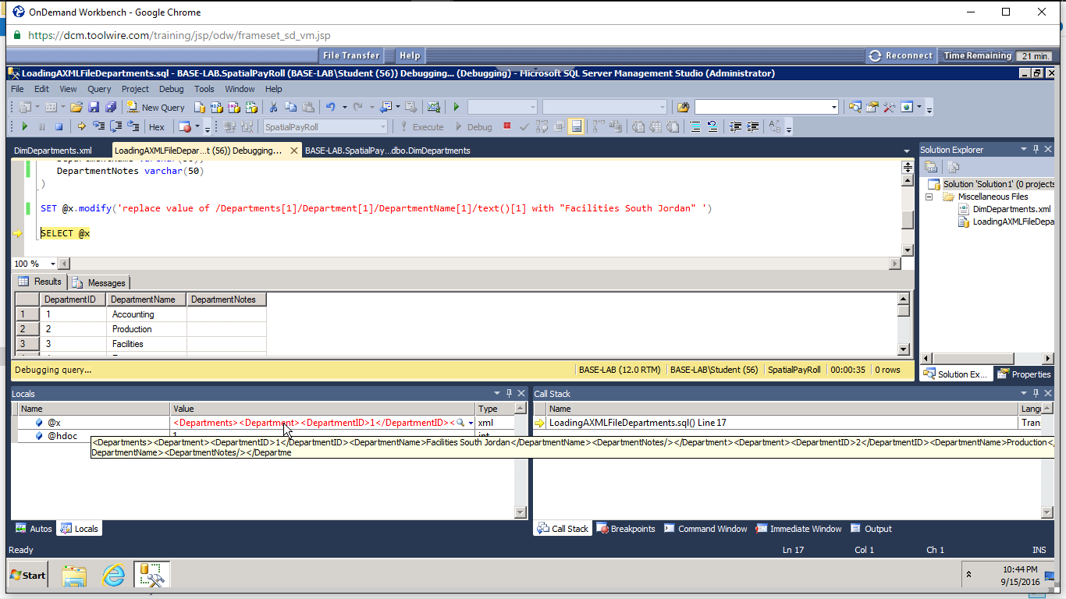
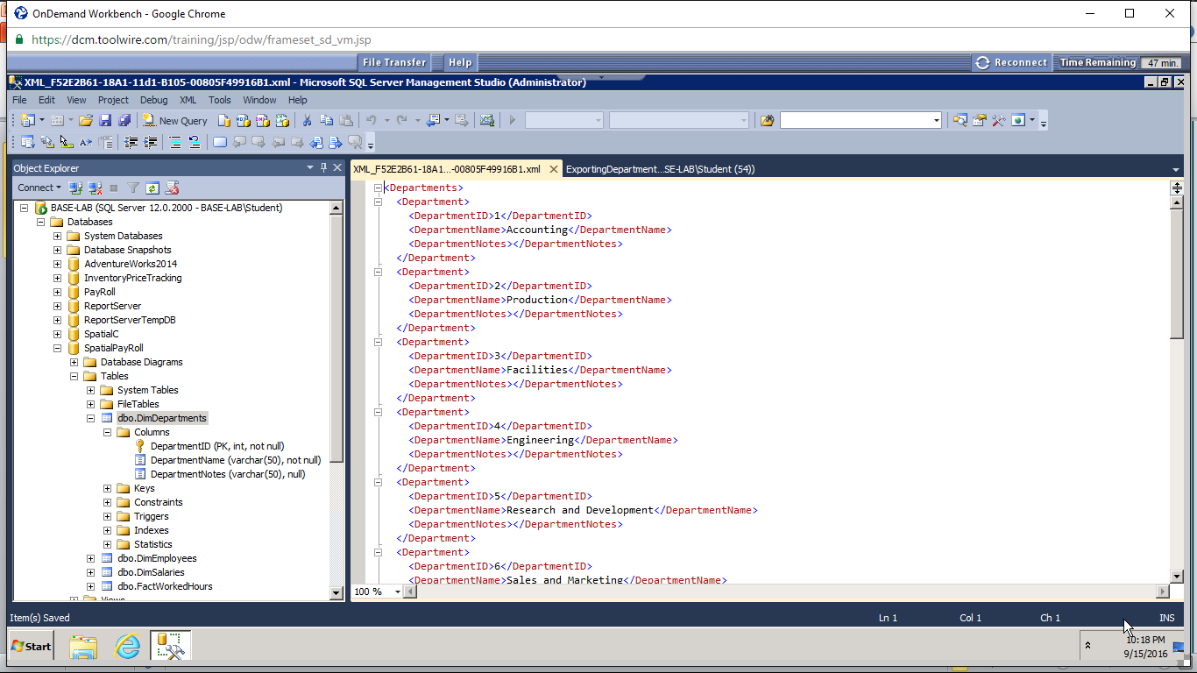
Test Script and Results

Slide 7
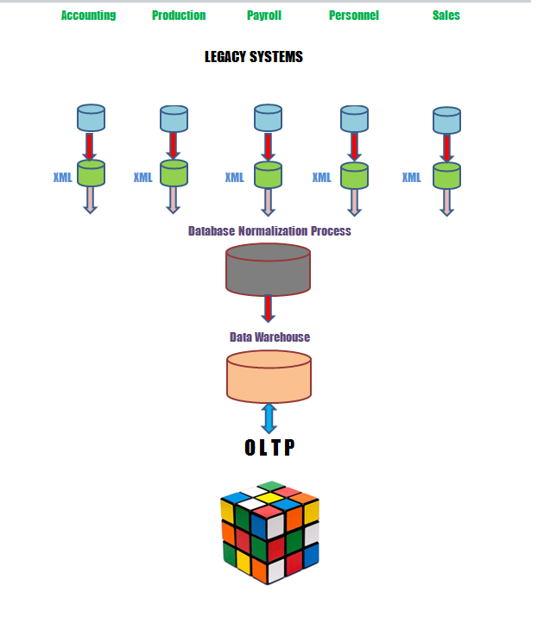
Data Migration Process Flow

Slide 8
Conclusion
The use of XML as a data interchange language facilitates the migration from the legacy systems to the Online Transaction Processing application (OLTP) for a faster process of the transactions. XML is a good choice for migrations between systems.

